Slide 1

A PROJECT PRESENTATION ON “FOUNDATION MANAGEMENT SYSTEM”

Slide 2
Submitted by:
Suthar Mukhtar (En. No. 20084231041)
Patel Dip(En. No. 20084231021)
Group No:
MSC(CA&IT) Sem. – III
P23A4IP1 (INDUSTRIAL PROJECT-I)
PROJECT INTERNAL GUIDE

Slide 3
1. Project Profile
Project Name: | Foundation Management System
Objective: | Foundation Management System adopts a functional framework using overaching managerial functions such as planning and decision making,organising,leading,controlling, and special topics in management.
Front End Tool: | PHP(8.0.9)
Back End Tool: | MySQL Server(8.0)
Other Tools: | Nodepad++,Visual Studio Code etc...
Platform of Application: | Web Application
Internal Project Guide:
Time Duration: | 90 Days
Submitted To: | Department of Computer Science, GANPAT UNIVERSITY.

Slide 4
2.Exsiting Sysem
Reduce the paper working.
Time Westing.
Manully Working and store the excel.
Individual calling.
Searching

Slide 5
3.System Features(Need for new system)
To create a web application to our organization.
To provide a online registration forUser.
Manage of the user
Online record management of Project.
Admin are manage Different activities like blood donner,Marrige help, study book help etc....
Admin Manage User activation and pin activation.
Admin Manage reward and income.
Searching.
To generate Report.

Slide 6
3.Functional Specification(User Wise)
There are three Users.
• Admin:
Manage user
Manage Course detail
Manage Create Group
Manage project detail
Manage project presentation schedule
Manage project presentation attandance.
• faculty:
registration,
view project detail
view Group,
view project schedule
Add project attandance
view Notification etc.

Slide 7
• Student:-
registration
view course detail
view group
view project detail
view project presentation schedule
view project presentation attadance
view report.

Slide 8
4.Functional Specification(Module Wise)
Module Specification :
Registration: Faculty and student are registration and manage his/her Profile.
Login: Admin and Member login in this module.
Manage User: Admin mange user like faculty and student and faculty can view Student Detail.
Course Detail:- Admin mange the Course Detail,student and faculty view the Course detail.
Project Detail: Admin mange the project detail,student and faculty view the project detail.
group: Admin create group , faculty and Student view group.
Prsentation Schedule: Admin manage project presentation, faculty and student view the project presentation.
Presentation Attandance : Admin Manages project attandance , faculty add the project Attandance and student view the project remark.
Notification:Admin can manage the notification and student can view the notification.
Report :Admin can generate the report.

Slide 9
5.SOFTWARE REQUIRMENT:-
SERVER SIDE
Operating System | Windows Server 2003 or any compatible server OS
Front End | PHP(5.5.12)
Back End | MySQL Server (5.6.17)
Web Server | Apache Web Server (2.4.9)
CLIENT SIDE
Web Browser | Internet Explorer 6.0 or any other Compatible Browser
Operating System | Any compatible Operating System

Slide 10
HARDWARE REQUIRMENT:-
SERVER SIDE
Processer | Pentium 2.2 GHz (min.)
RAM | 4 GB
Free Hard disk space | 10 GB
CLIENT SIDE
Processer | Pentium 1.60 GHz (min.)
RAM | 2 GB
Free Hard disk space | 1 GB

Slide 11
6.System Flowchart
START
IS REGISTER?
NO
REGISTRATION
YES
YES
LOGIN
NO
YES
IS VALID?
YES
IS ADMIN ?
NO
IS FACULTY?
NO
YES
YES
YES
C
A
B

Slide 12
A
B
C
MANAGE USER
VIEW COURSE DETAIL
VIEW COURSE DETAIL
MANAGE COURSE DETAIL
VIEW PROJECT DETAIL
VIEW PROJECT DETAIL
MANAGE PROJECT DETAIL
VIEW GROUP
VIEW GROUP
MANAGE GROUP
VIEW PROJECT PRESENTATION
ADD PROJECT ATTANDANCE
MANAGE PROJECT PRESENTATION
MANAGE PROJECT ATTANDANCE
VIEW PROJECT PRESENTATION
MANAGE PROJECT ATTANDANCE
LOGOUT
STOP

Slide 13
7.Data Flow Diagram
7.0 Context Level Diagram
Manage User Info,Course Info,Project Detail Info,Group Info,Project Attandance Info,Generate Report Info
Project Management System
Regisration,Login
Admin
Student
View User Info & Course Info,view Project Detail Info,View Group Info,view Project Attandance Info, Report Info
View group Detail ,View Project Detail Info,View ProjectPresentation,View Project Attandance Info.
View Profile Deatial, Student Info ,View Project Detail Info,View Project presentation,View Project Attandance Info.
Manage Profile, Fill Project Attandance ,Add Project Remark.
faculty

Slide 14
7.1First Level Diagram (Process Wise)
1.0
Registration
Get Registration Detail
StoreRegistration Detail
Student_Mst
Student
Registration info
Registration info
Store Login info
Login info
Faculty_Mst
Login
Info
Store Login info
Login info
Verify Username & Password
2.0
Login
Faculty
View Login Info
View Login Info
Verify Username & Password
Admin_Mst
Admin
User Info
Verify Username & Password
View Login Info
Get Username & Password
A
B
View Login Info

Slide 15
A
B
Manage User Info
3.0
Manage User
Store User Detail
Admin
Get User Info
Student_Mst
Get User Detail
User info
Get Faculty Detail
Store Faculty Detail
View User Detail
View Faculty Info
Faculty_Mst
Faculty Info
Get Course
Faculty
4.0
Course Detail
View Course
Detail
Check Manage
Course
Get Course Detail
Tb1_Course
Student
GroupInfo
Course Detail
View Course Detail
Manage Course Detail
A
B
Course Info

Slide 16
A
B
Manage GroupInfo
5.0
Manage Group
Store Group Detail
Admin
Get Group Info
Tb1_Group
Get Group Detail
Group info
Get Group Detail
View Group Detail
View Group Info
Get Project
Faculty
6.0
Project Detail
View Project
Detail
Check Project
Get Project Detail
Tb1_Project Detail
Student
Project Schedule Info
Give Project Detail
View Project Detail
Manage Project Detail
A
B
Project Info

Slide 17
A
Manage Project Schedule Info
B
7.0
Project
Presentation Schedule Detail
Store Presentation Schedule Detail
Admin
Schedule Info
Tb1_Presentation Schedule_Mst
Get presentation ScheduleInfo
Presentation info
Get Schedule Detail
View Schedule Detail
View Project Schedule Info
Get Project Attandance
Faculty
View Attandance
8.0
Project Attandance Detail
Check Project Attandance
Get Project Attandance Detail
Tb1_Project Attandance
Student
Give Project Attandance Detail
View Project Attandance Detail
Notification Info
Manage Project Attandance Detail
A
B
Project Attandance Info

Slide 18
A
Get Notification Detail
9.0
Notification
Store Notification Detail
B
Student
Tb1_Notification
Notification info
Get Notification Detail
Notification info
Faculty
Notification info
Manage Notification info
View Notification info
10.0
Generate report
Request For Report
Admin
Report
View Report

Slide 19
8.Data Dictionary
1.Admin Table:-
Table Name | Admin_Mst
Table Description
Primary Key | ------
Foreign Key | -----
Notes:
To store admin detail Username & Password etc.

Slide 20
Sr | Field Name | Data Type | Constraint | Description | Sample Data
1 | Username | Varchar(30) | Not null | Store the User Name . | 1040
2 | Password | Varchar(25) | Not null | Store the Password . | deep

Slide 21
2.Student_Mst:-
Table Name | Student_Mst
Table Description | To Store Student detail like Student name, address, city, contact no etc.
Primary Key | Std_no
Foreign Key | Sem_id(Ref:-semester_Detail(sem_id)).

Slide 22
Sr. | Field Name | Data Type | Constraint | Description | Sample Data
1 | Std_no | Int(11) | Primary key | Store the Student no | 1
2 | Std_id | Int(11) | Not null | Store the Student Id | 1040
3 | Std_Name | Varchar(30) | Not null | Store the Student Name | deep
4 | City | Varchar(20) | Not null | Store the City | idar
5 | Pincode | Numeric(6) | Not null | Store the Pincode | 123456
6 | Address | Varchar(50) | Not null | Store the Address | hmt
7 | Email | Nvarchar(30) | Not null | Store the Email Id | dip1040@gmail.com

Slide 23
8 | Password | Varchar(30) | Not null | Store the password | 123456
9. | Mobile_No | Numeric(12) | Not null | Store the Mobile No | 9087654321
10. | Sem_no | Int(11) | Foreign key | Store the Sem No | III

Slide 24
3.Faculty_Mst:-
Table Name | Faculty_Mst
Table Description | To Store Faculty detail like Faculty name, address, city, contact no etc.
Primary Key | F_no
Foreign Key | ----

Slide 25
Sr. | Field Name | Data Type | Constraint | Description | Sample Data
1 | F_No | Int(11) | Primary key | Store the Faculty no | 1
2 | F_id | Int(11) | Not null | Store the Faculty Id | 3001
3 | Faculty_Name | Varchar(20) | Not null | Store the Faculty Name | Ketan Patel
4 | City | Varchar(10) | Not null | Store the City | mehsana
5 | Pincode | Numeric(6) | Not null | Store the Pincode | 345678
6 | Address | Varchar(50) | Not null | Store the Address | mehsana
7 | Email | Nvarchar(30) | Not null | Store the Email Id | ganpat@gmail.com

Slide 26
8 | Password | Varchar(10) | Not null | Store the Faculty Password | 12345
9 | Mobile No | Numeric(12) | Not null | Store the Mobile No | 90876454321

Slide 27
4.Course_Mst:-
Table Name | Course_detail
Table Description | To Store Course detail like Course name, intact, date, description etc.
Primary Key | C_No
Foreign Key | ----

Slide 28
Sr. | Field Name | Data type | Constraint | Description | Sample Data
1 | C_no | Int(11) | Primary key | Store the Course no | 1
2 | Course_id | Varchar(11) | Not null | Store the Course id | c101
3 | Course_name | Varchar(30) | Not null | Store the Course name | Bsc(ca&it)
4 | Course_Type | Varchar(30) | Not null | Store the Course type | Post graduate

Slide 29
5.Semester_Mst:-
Table Name | semester_mst
Table Description | To Store semester detail like sem name, sem id,course no etc.
Primary Key | Sem_no
Foreign Key | C_no(ref:-course_mst(c_no))

Slide 30
Sr. | Field Name | Data type | Constraint | Description | Sample Data
1 | sem_no | Int(11) | Primary key | Store the Course no | 1
2 | Course_no | Int(11) | Foreign key | Store the Course no | c101
3 | sem_name | Varchar(30) | Not null | Store the sem name | III

Slide 31
6.Group:-
Table Name | Group_detail
Table Description | To Store Group detail like Group no, Student Id1, Student Id2,Student Id3,Faculty Id etc.
Primary Key | G_no
Foreign Key | Std_id1,std_id2,std_id3,F_no(Ref:Student_mst,Faculty(std_id1,std_id2,std_id3,F_no))

Slide 32
Sr. | Field Name | Data Type | Constraint | Description | Sample Data
1 | group_no | Int(11) | Primary Key | Store the group no. | 1
2 | Group_id | Int(11) | Not null | Store the group id | 1
3 | Std_id1 | Int(11) | Foreign key | Store the std id1. | 1040
4 | Std_id2 | Int(11) | Foriegn key | Store the std id2. | 2001
5 | Std_id3 | Int(11) | Foreign key | Store the std id3. | 1076
6 | F_no | Int(11) | Foreign Key | Store the faculty no. | 1

Slide 33
7.Project_detail:-
Table Name | project_detail
Table Description | To Store Project detail like project name, Group no, platform, Front End,Back End,Description etc.
Primary Key | Project_no
Foreign Key | G_no(Ref:group_mst(g_no))

Slide 34
Sr. | Field Name | Data Type | Constraint | Description | Sample Data
1 | Project_no | Int(11) | Primary key | Store the project no. | 1
2 | Group_no | Int(11) | Foreign Key | Store the group no. | 1
3 | Project_definition | Varchar(100) | Not null | Store the project definition. | Project management system
4 | Platform | Varchar(50) | Not null | Store the paltfrom. | Web application
5 | Front End | Varchar(50) | Not null | Store the front end. | Php
6 | Back End | Varchar(50) | Not null | Store the back end | Mysql

Slide 35
7 | Other Tool | Varchar(50) | Not null | Store the other tool. | Notepad++
8 | Project_Objective | Varchar(150) | Not null | Store the project objective. | Project management system objective……….
9 | Project_file | Varchar(50) | Not null | Store the project file. | P1.doc

Slide 36
7.Presentation_Mst:-
Table Name | presentation_Mst
Table Description | To Store presentation_mst detail like presentation no,presentation topic,course id,semester id etc.
Primary Key | P_no
Foreign Key | Sem_no(Ref:-semester_detail(sem_no))

Slide 37
Sr. | Field Name | Data Type | Constraint | Description | Sample Data
1 | P_no | Int(11) | Primary Key | Store the presentation no. | 1
2 | P_id | Int(11) | Not null | Store the presentation id. | 1
3 | Presentation_Topic | Varchar(150) | Not null | Store the presentation topic. | Project management system
4 | Sem_no | Int(11) | Foreign key | Store the semester no. | 1

Slide 38
8.Presentation Schedule:-
Table Name | presentation_schedule
Table Description | To Store presentation_schedule detail like presentation no,presentation topic,presentation date etc.
Primary Key | Pre_sch_no
Foreign Key | P_no(Ref:-presentation_mst(p_no))

Slide 39
1 | Pre_sch_no | Int(11) | Primary Key | Store the presentation schedule no. | 1
2 | P_no | int(11) | Foreign key | Store the presentation no. | 1
3 | group_id | Int(11) | Not null | Store the group id. | 1
4 | Presentation_date | Date | Not null | Store the presentation date. | 2019/08/03

Slide 40
8.Presentation_Attendance:-
Table Name | presentation_attendance
Table Description | To Store presentation attendance detail like group id,std_id1,std_id2,std_id3,date,suggestion, sem_no etc.
Primary Key | Pre_att_no
Foreign Key | Std_id1,std_id2,std_id3,sem_no(Ref:Student_mst,,semester_mst(std_id1,std_id2,std_id3,F_id,c_id,f_id))

Slide 41
1 | Pre_att_no | Int(11) | Primary key | Store the presentation attendance no. | 1
2 | P_no | Int(11) | Foreign key | Store the presentation no. | 1
3 | group_Id | Int(11) | Not null | Store the group id. | 1
4 | Std_id1 | Int(11) | Foreign key | Store the std id1. | 1040
5 | Std_id2 | Int(11) | Foriegn key | Store the std id2. | 2001
6 | Std_id3 | Int(11) | Foreign key | Store the std id3. | 1076
7 | Suggestion | Varchar(150) | Not null | Store the suggestion. | Er diagram incomplete
8 | Date | Date | Not null | Store the date | 2019/09/06
9 | Sem_no | Int(11) | Foreign Key | Store the semester id. | 1

Slide 42
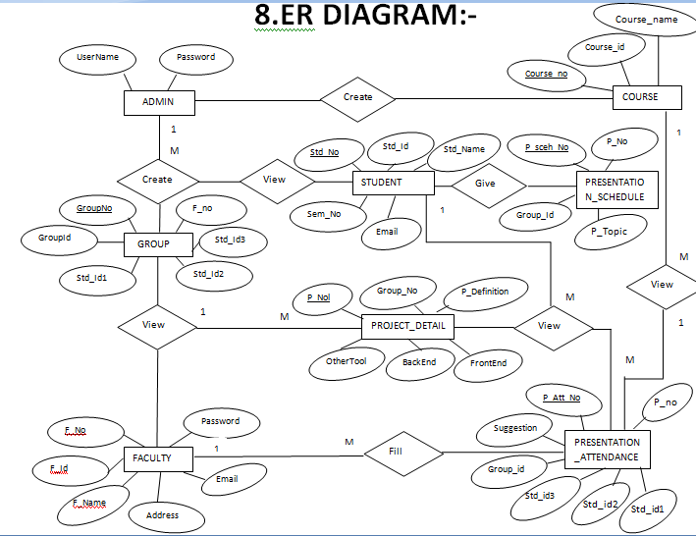
ER DIAGRAM:-

Slide 43
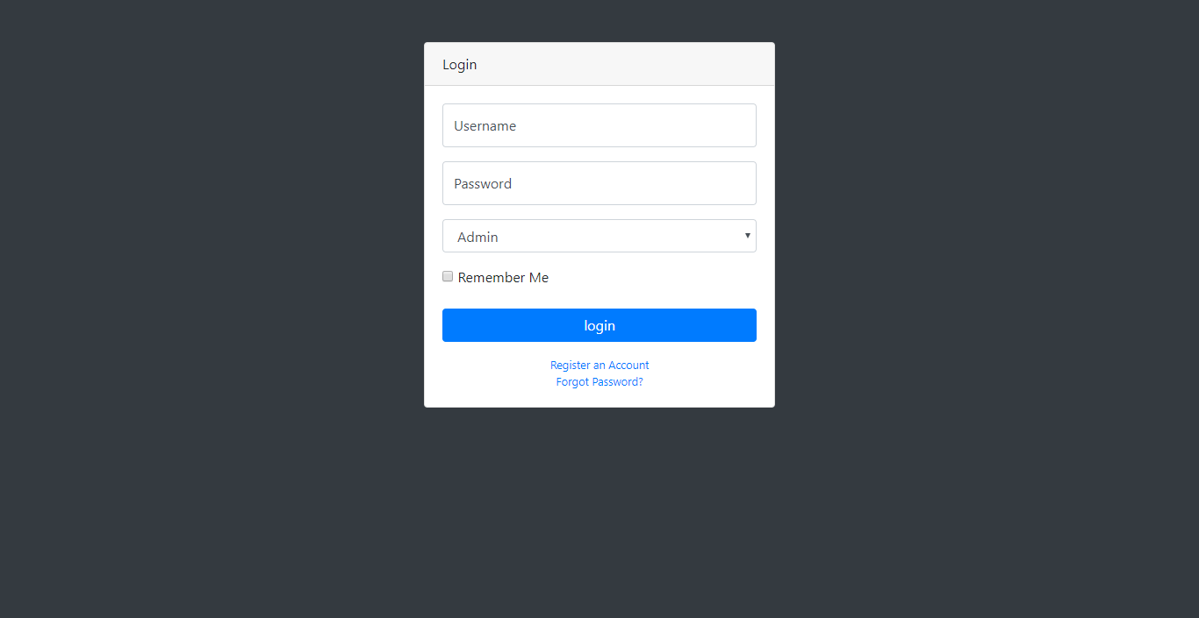
--Design Output Admin
Description:
This Form is Admin Login Form. If Login Successful then access admin panel.

Slide 44
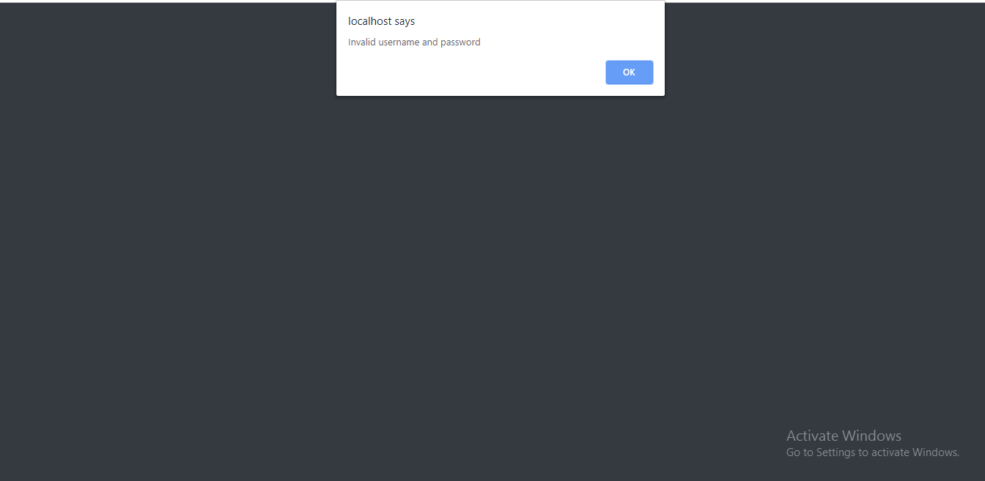
Description:
This Page show the Error Message When the Admin Can Write Wrong Username & Password.

Slide 45
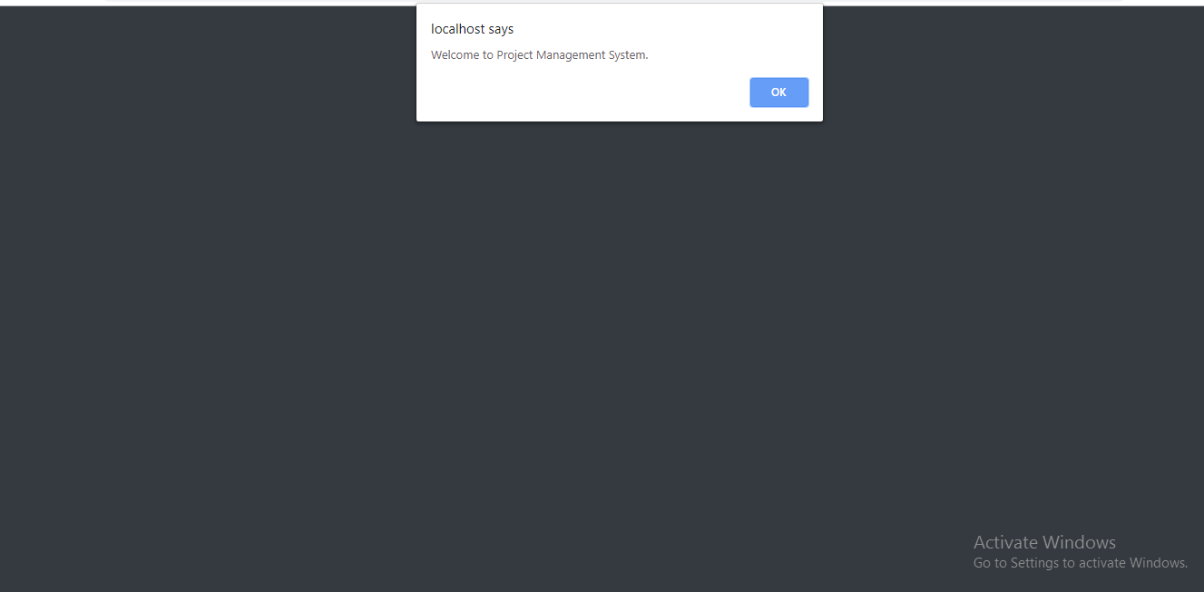
Description:
This Page Show the Message When The Username & Password Is Right.

Slide 46
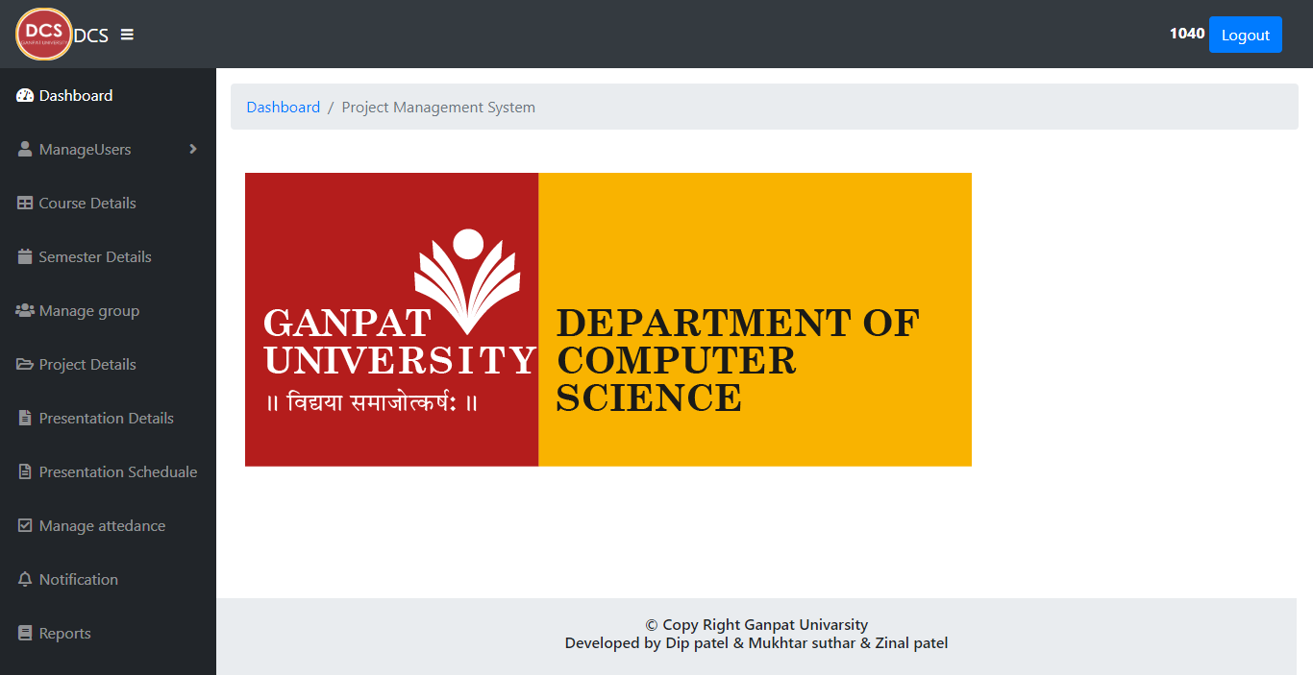
Description:
This is main page of the admin side. Admin can Access all the module from here.

Slide 47
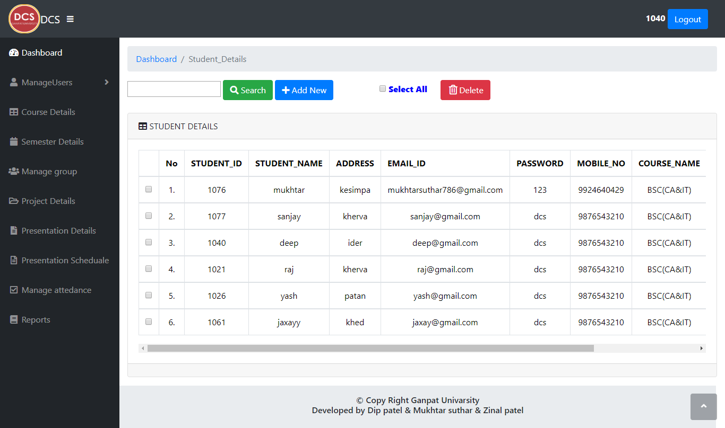
Description:
This page show the student list which are store in the database.

Slide 48
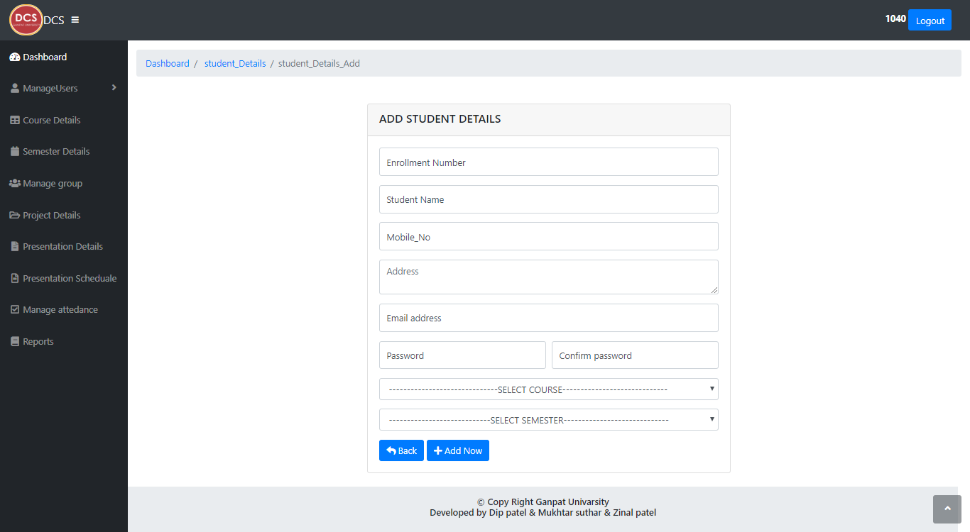
Description:
This Form is student add form. In this Form the admin can add the student Details.

Slide 49
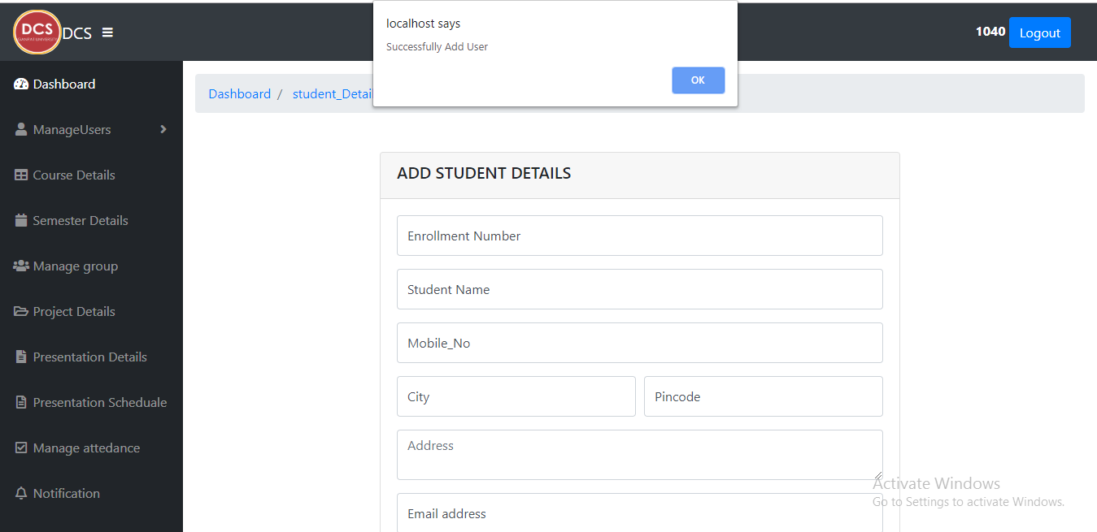
Description:
This Message bow show the message when the student details are successfully inserted into database.

Slide 50
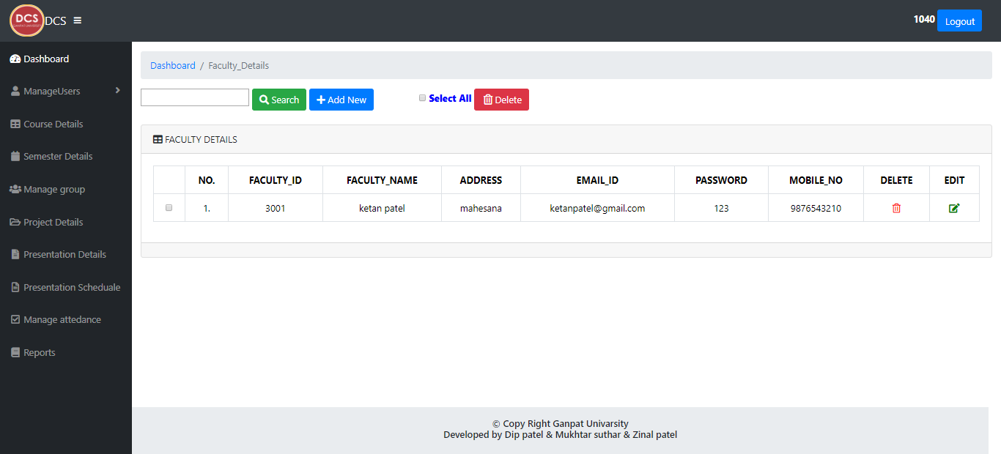
Description:
This page show the faculty list which are store in the database.

Slide 51
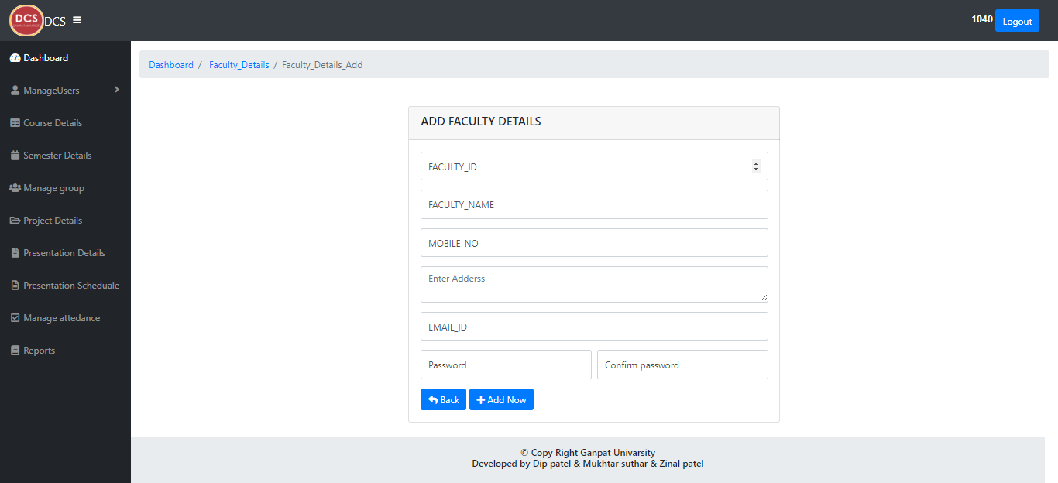
Description:
This Form is faculty add form. In this Form the admin can add the faculty Details.

Slide 52
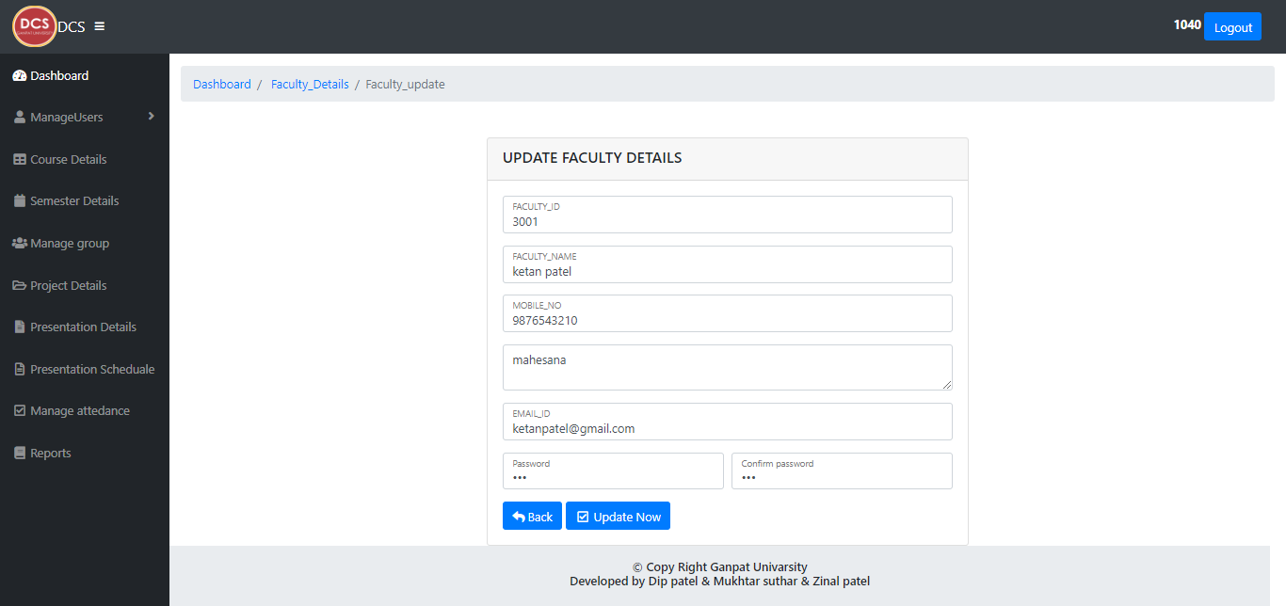
Description:
This Form is faculty update form. In this Form the admin can Update the faculty Details.

Slide 53
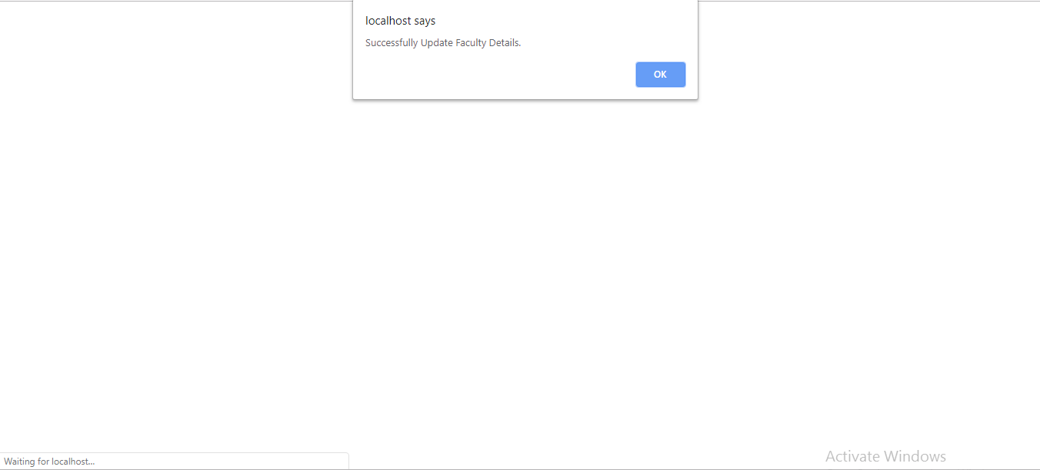
Description:
This Popup box show the message when the faculty details successfully updated.

Slide 54
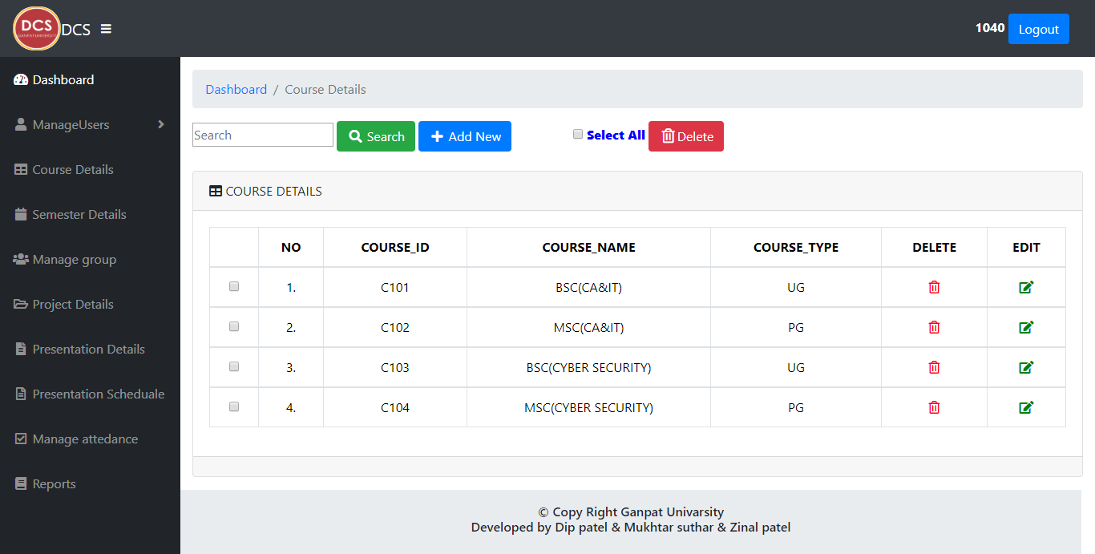
Description:
This page show the course detail which are store in the database.

Slide 55
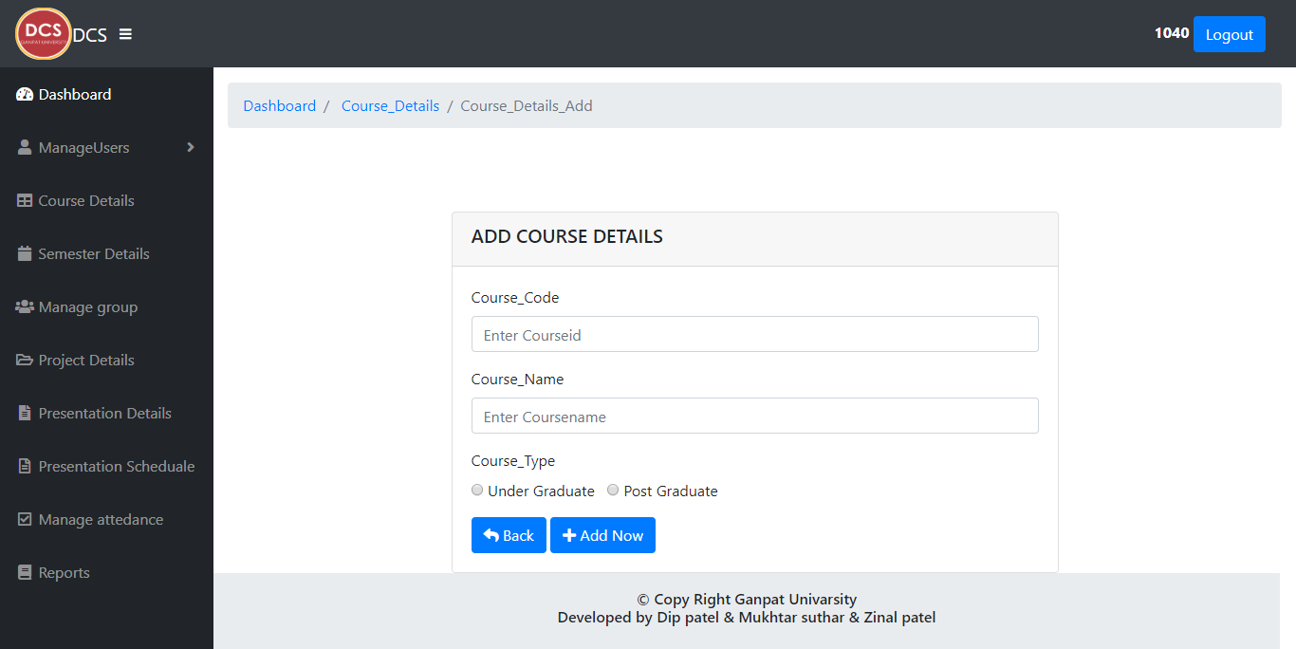
Description:
This Form is course add form. In this Form the admin can add the course Details.

Slide 56
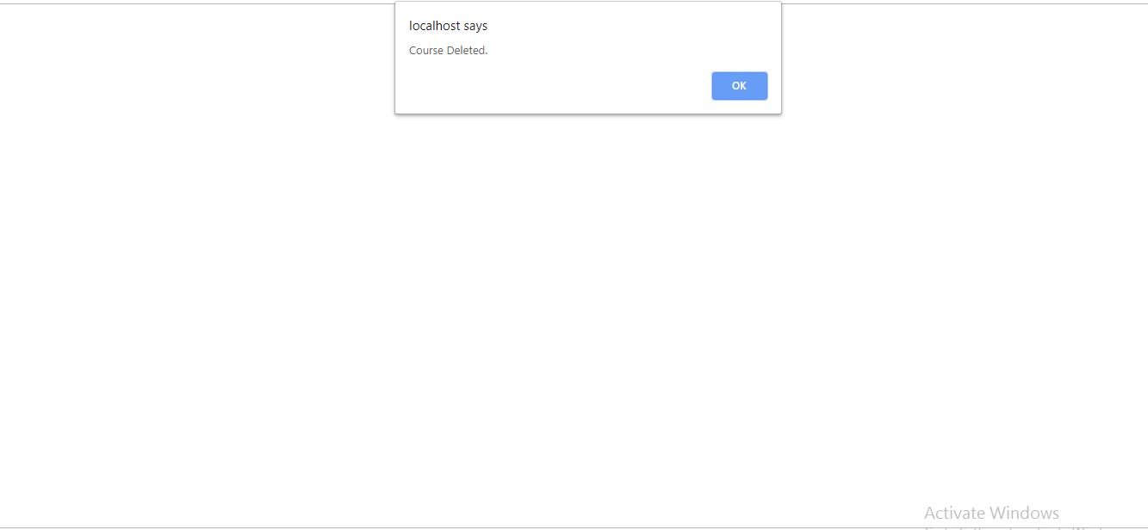
Description:
This Popup bow show the message when the course details are Deleted.

Slide 57
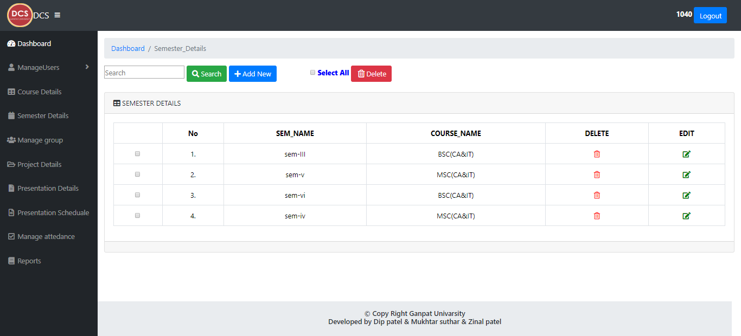
Description:
This page show the semester detail which are store in the database.

Slide 58
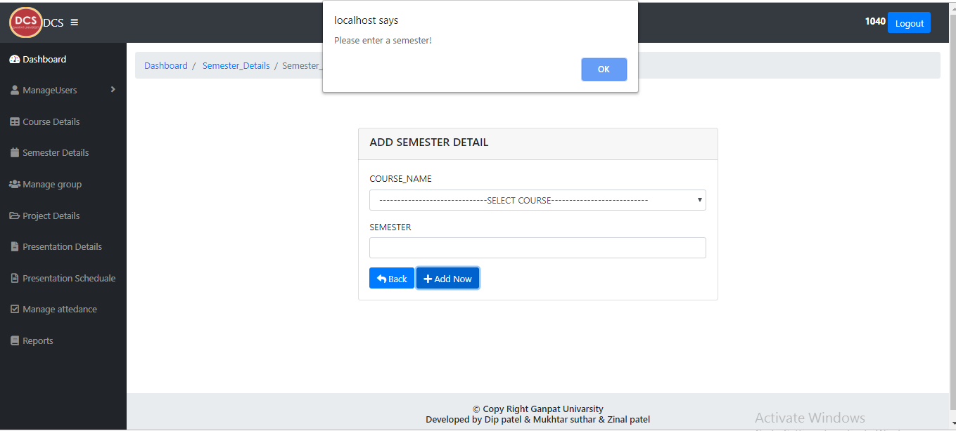
Description:
This Page show the Error Message When the Admin Can Write please enter the semester id.

Slide 59

Description:
This page show the group detail which are store in the database.

Slide 60
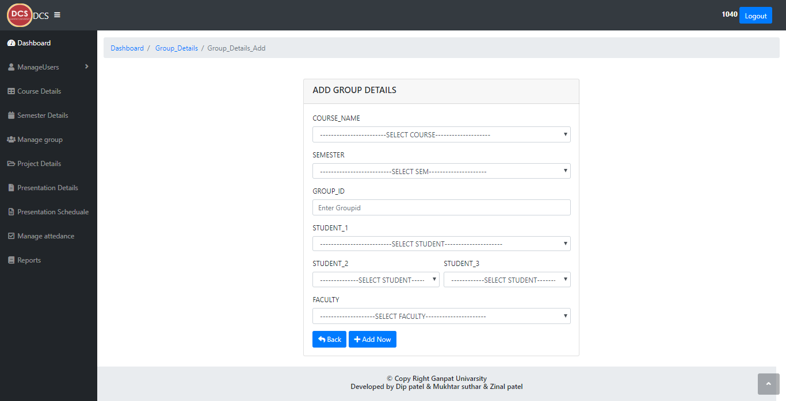
Description:
This Form is group add form. In this Form the admin can add the group Details

Slide 61
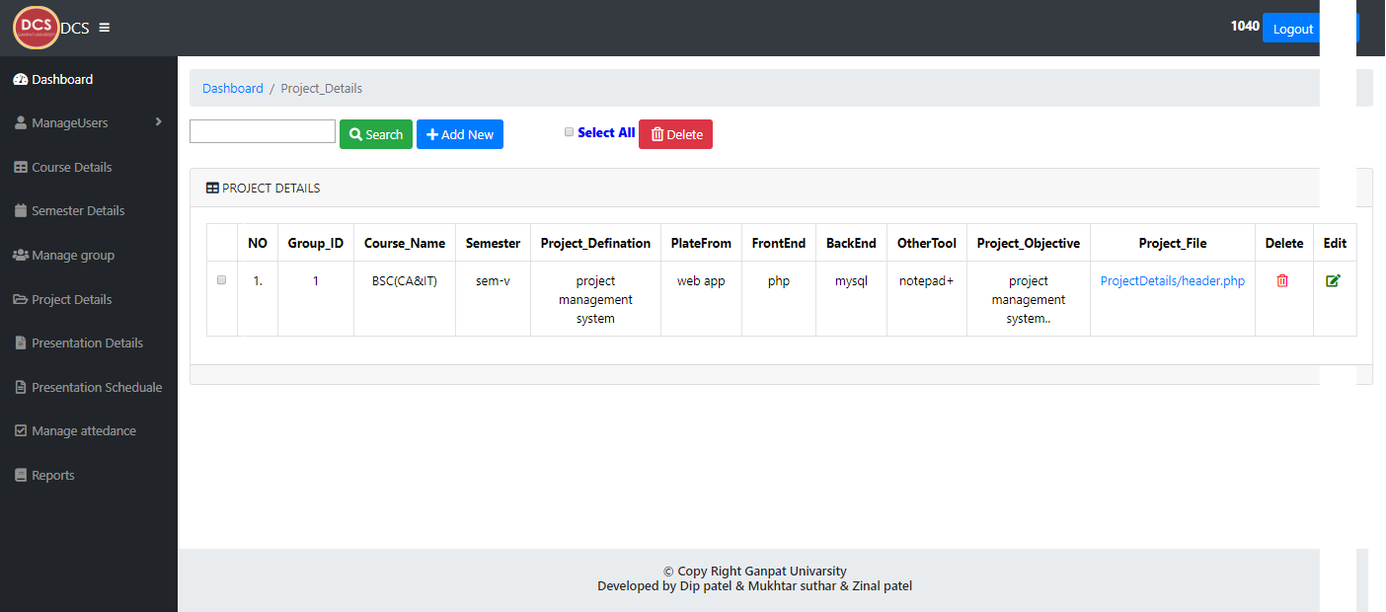
Description:
This page show the project detail which are store in the database.

Slide 62
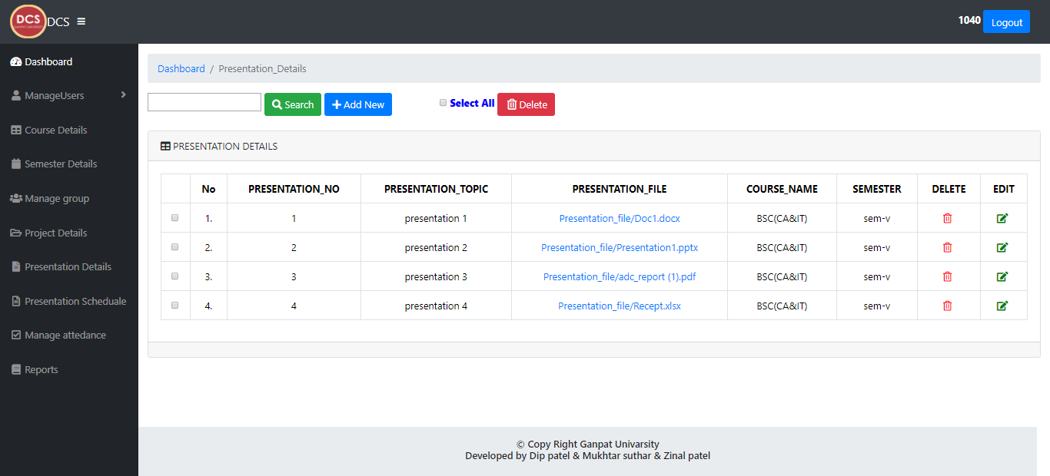
Description:
This page show the presentation detail which are store in the database.

Slide 63
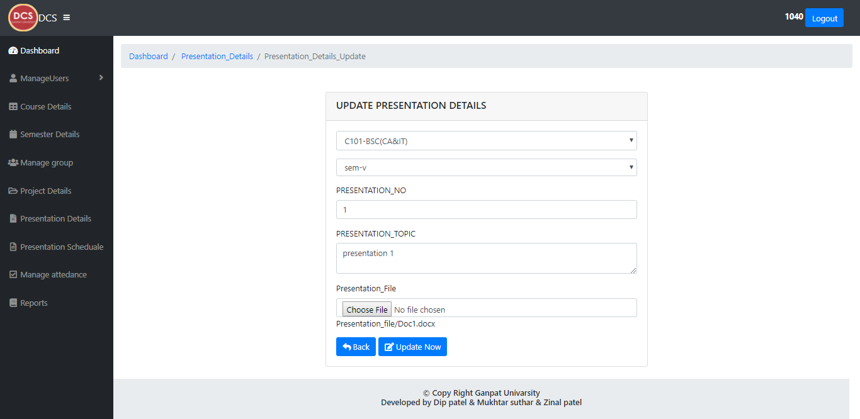
Description:
This Form is presentation update form. In this Form the admin can Update the presentation Details.

Slide 64
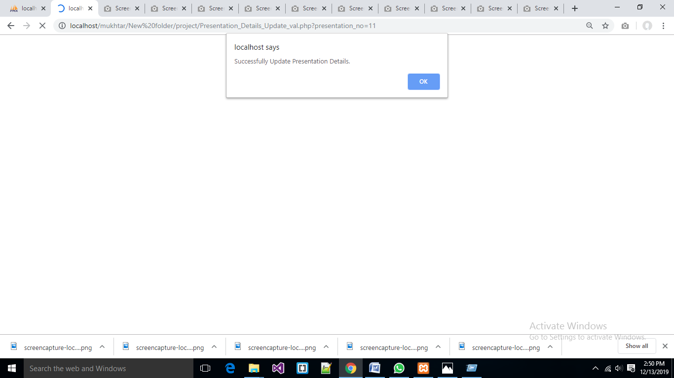
Description:
This Popup box show the message when the presentation details successfully updated.

Slide 65

Description:
This page show the presentation schedule detail which are store in the database.

Slide 66
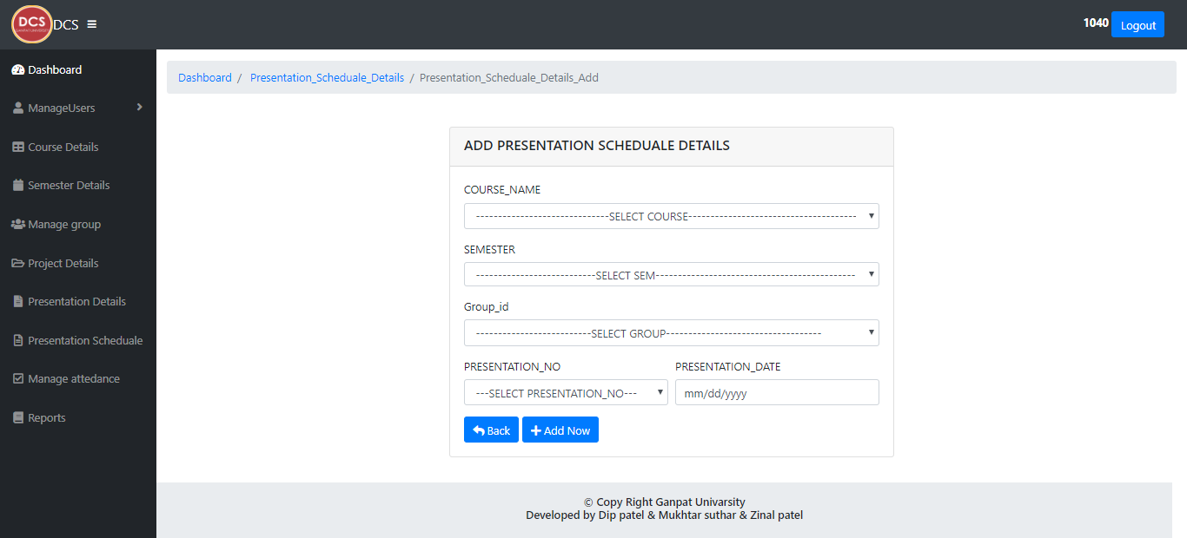
Description:
This Form is schedule add form. In this Form the admin can add the schedule Details.

Slide 67
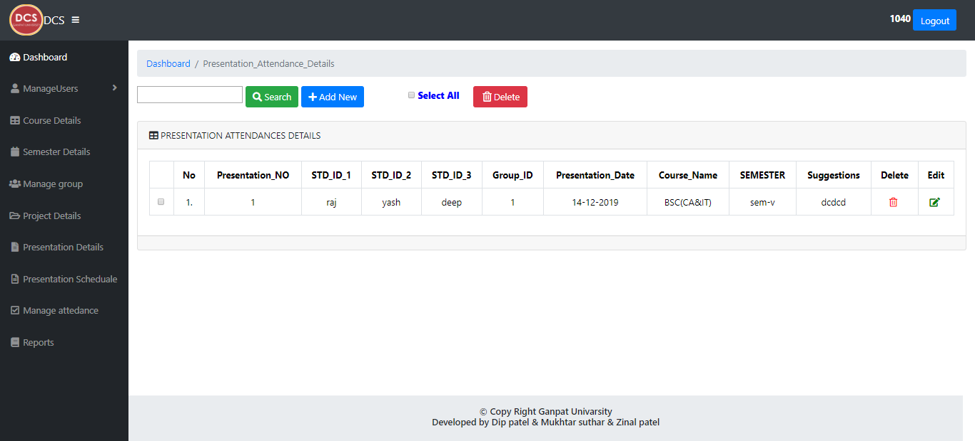
Description:
This page show the presentation attendance detail which are store in the database.

Slide 68
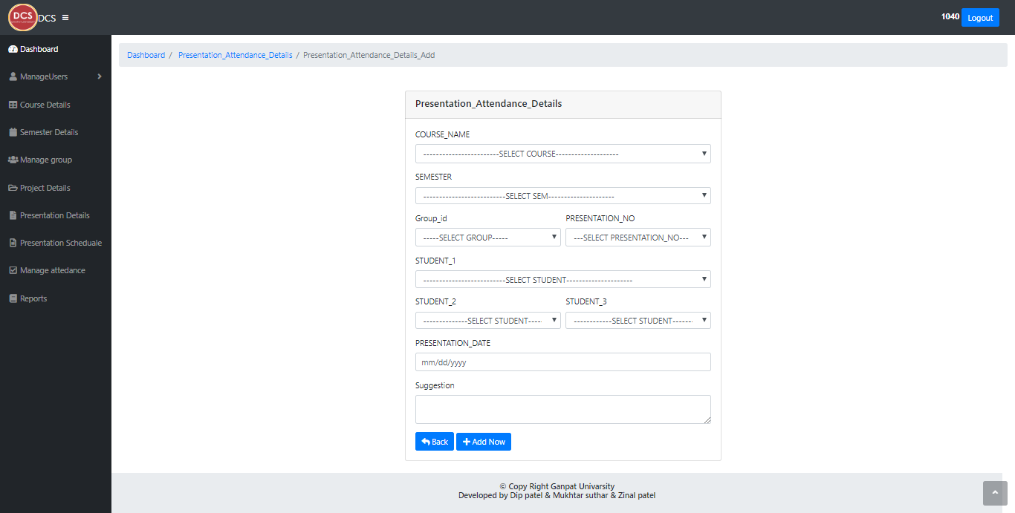
Description:
This Form is attendance add form. In this Form the admin can add the attendance Details.

Slide 69

Description:
This Form is presentation attendance update form. In this Form the admin can Update the presentation attendance Details.

Slide 70
Description:
This Popup box show the message when the presentation attendance successfully updated.

Slide 71
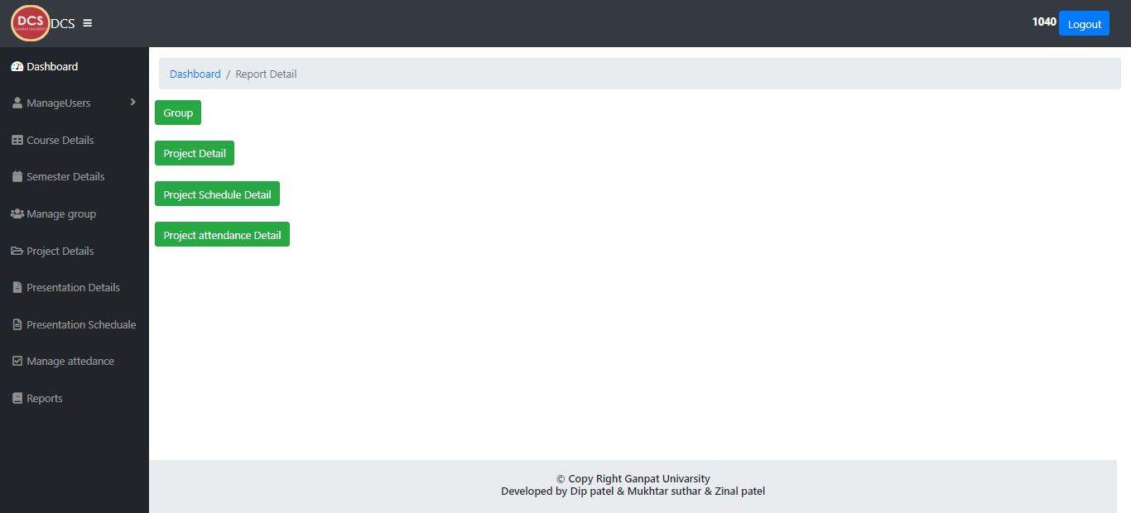
Description:
This page is report page. Using this page admin can see the different different details of the project.

Slide 72
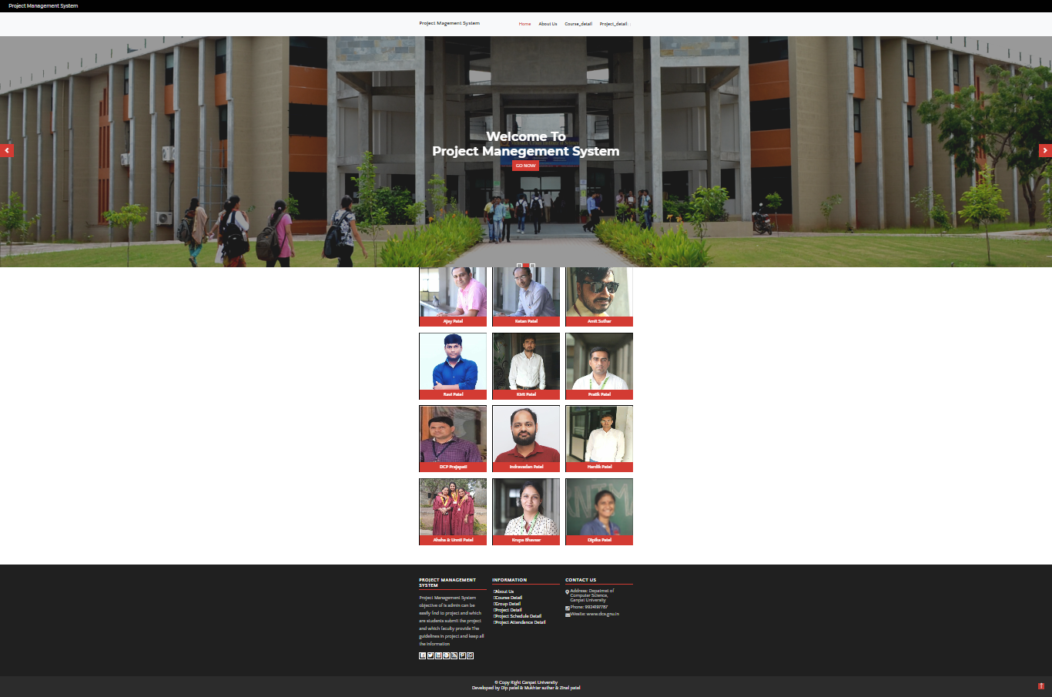
User Panel:-
Description:
This is main page of the user panel. Use of this page can in different course,group,project detail,schedule detail.

Slide 73
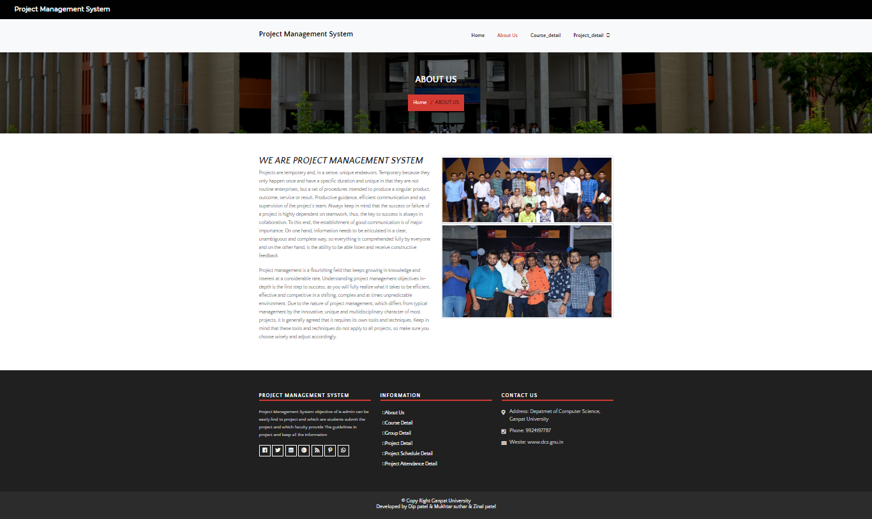
Description:
This is page of the user panel. Use of this page can about us page.

Slide 74
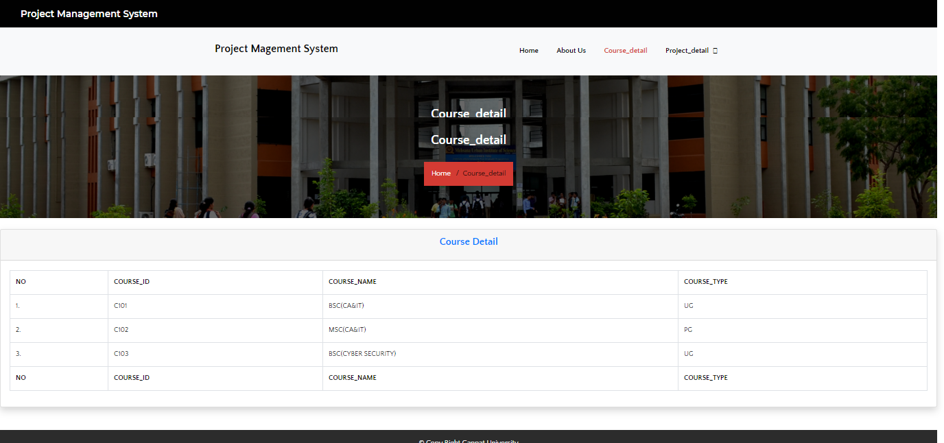
Description:
This page show the course detail which are store in the database.

Slide 75
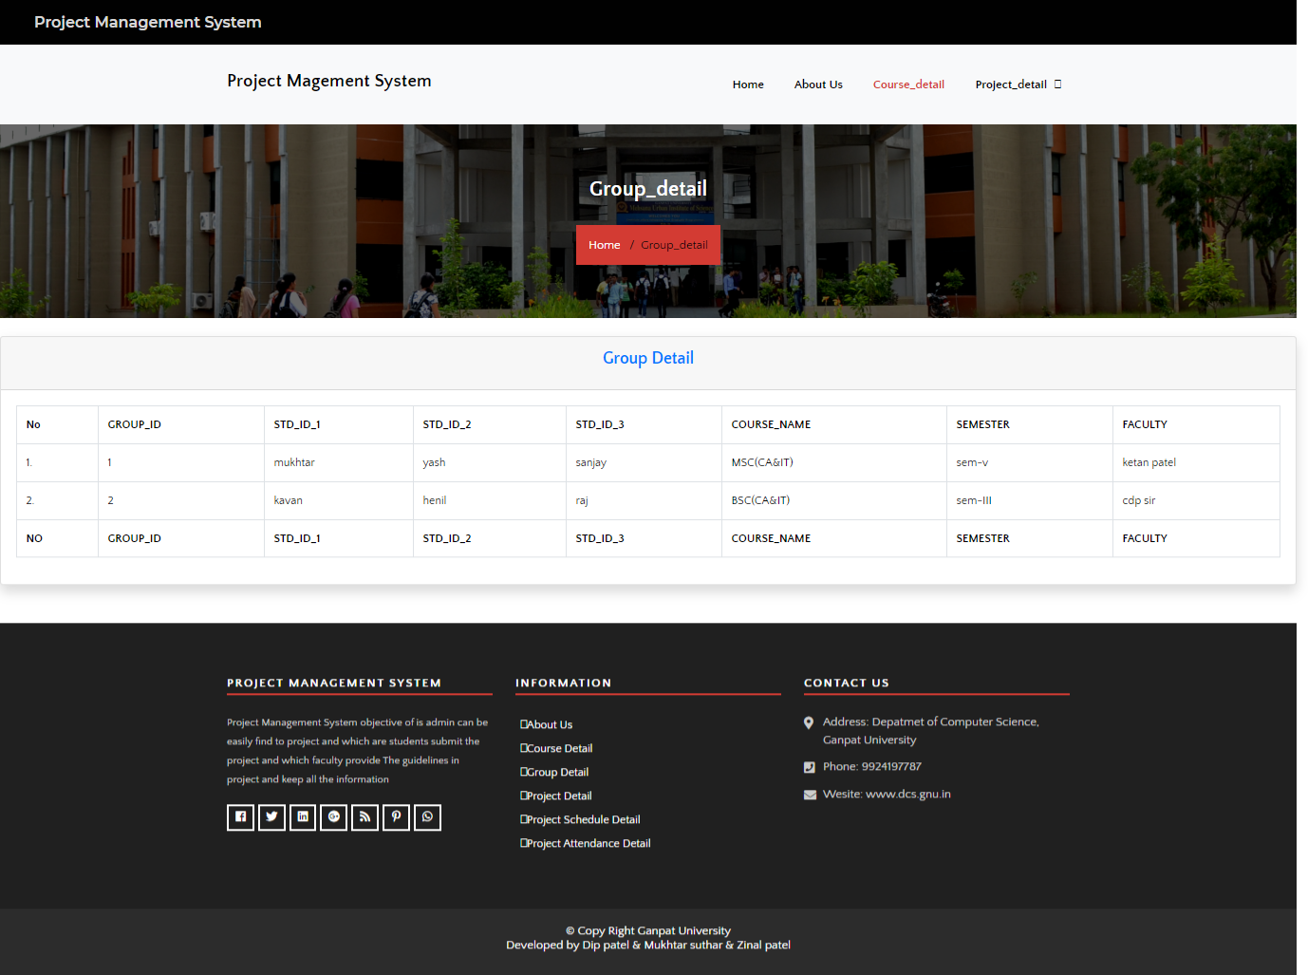
Description:
This page show the group detail which are store in the database.

Slide 76
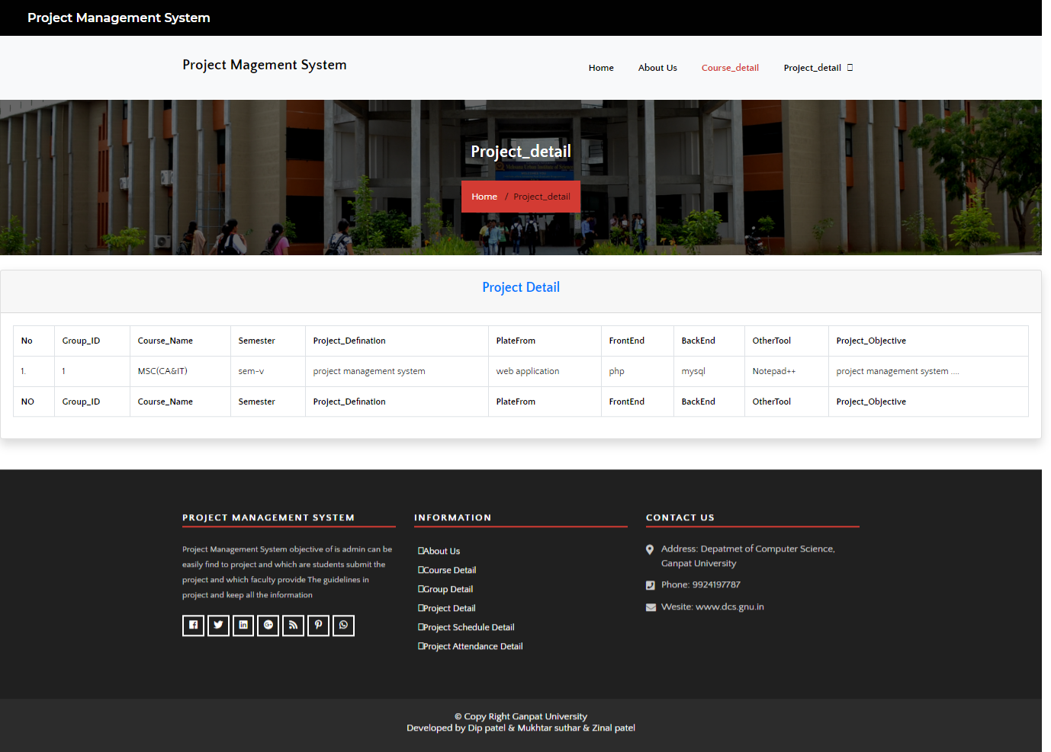
Description:
This page show the project detail which are store in the database.

Slide 77
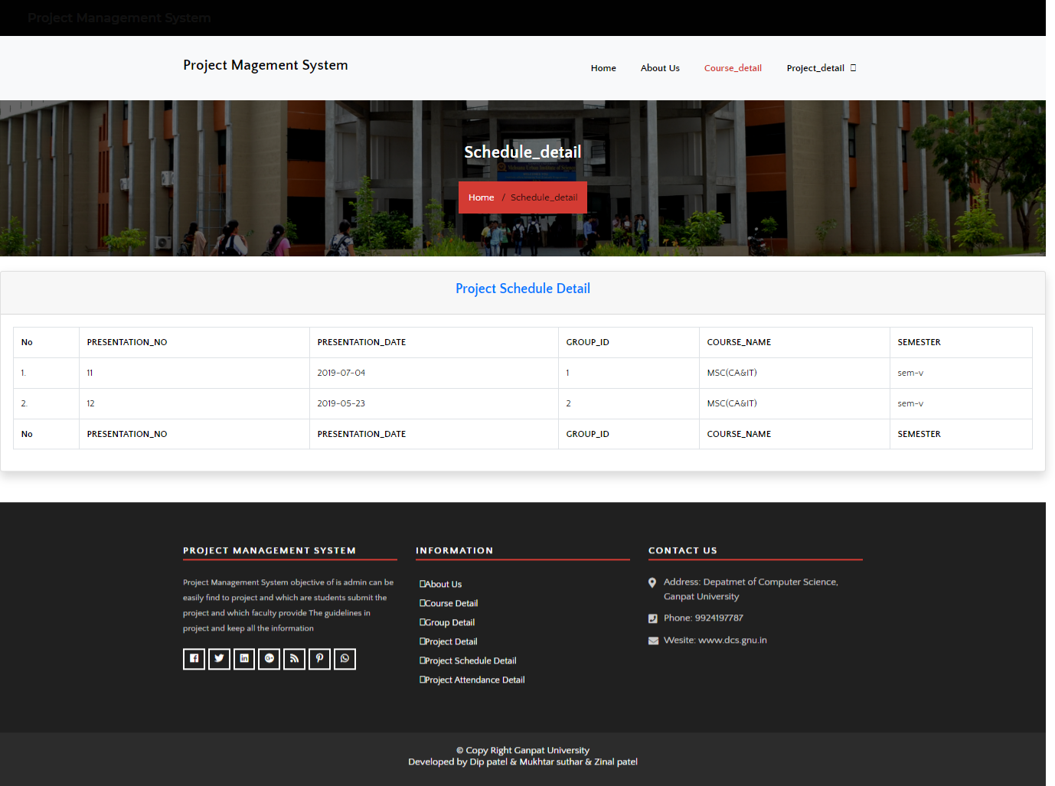
Description:
This page show the project schedule detail which are store in the database.

Slide 78
Testing:-
Id | Scenario | Test Cases | Expected Result | Actual Result | Pass/Fail
1 | Registration | Enter null in mandatory fields. | It should not do the registration and show error | It will show message that enter the data. | Pass
 |  | Enter incorrect data | It should not do the registration and show error. | It will show message that enter the correct data. | Pass
 |  | Enter correct data of all required field | It should let do registration.. | It will show the message of successfully registration | Pass
2 | Login | Enter null username or password. | It should not do the login n show error. | It will show message that enter username and password. | Pass
 |  | Enter wrong data of username or password. | It should not do the login show error. | It will show message that enter correct username or password. | Pass
 |  | Enter correct data of username or password. | It should let do login. | It will show the message of successfully login. | Pass

Slide 79
3 | Validation Test case | Required Field Validation |  | Mandatory Fields should not be blank |  | You have to enter some value into mandatory field |  | Pass
 |  | Range Validation |  | The field value must have the predefined range |  | Only 10 number are enter in the field |  | Pass
 |  | Fixed format validation |  | A predefines format should be follow |  | Check the proper format of E-Mail Id |  | Pass
4 | System Test | In system test the whole system is tested. The whole system works properly. The page navigation is proper and links are given properly.
5 | Unit Test | In unit test each form is tested separately. In this system each form is separately run under different condition and checked all validation.
6 | Validation Test case | Required Field Validation | Mandatory Fields should not be blank |  | You have to enter some value into mandatory field |  | Pass
 |  | Range Validation | The field value must have the predefined range |  | Only 10 number are enter in the field |  | Pass
 |  | Fixed format validation | A predefines format should be follow |  | Check the proper format of E-Mail Id |  | Pass

Slide 80
Future Enhancement
May be including Page Themes User Friendly.
Web application.
May be make this Website Attractive and Fill Up the User Requirements.

Slide 81
15. Bibliography:-
Websites :
WWW .stackoverflow . Com WWW .W3school.com WWW. Quora.com
WWW.tutorialspoint.com

